Slide 1
What Are The Short And Long Term Effects Of Fluoride In The Human Body & What Are The Most Common Methods Of Ingestion?
Jenessa Dyke & Jessica Cheung

Slide 2
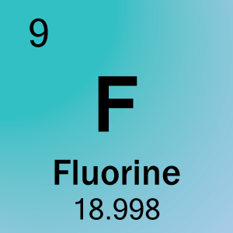
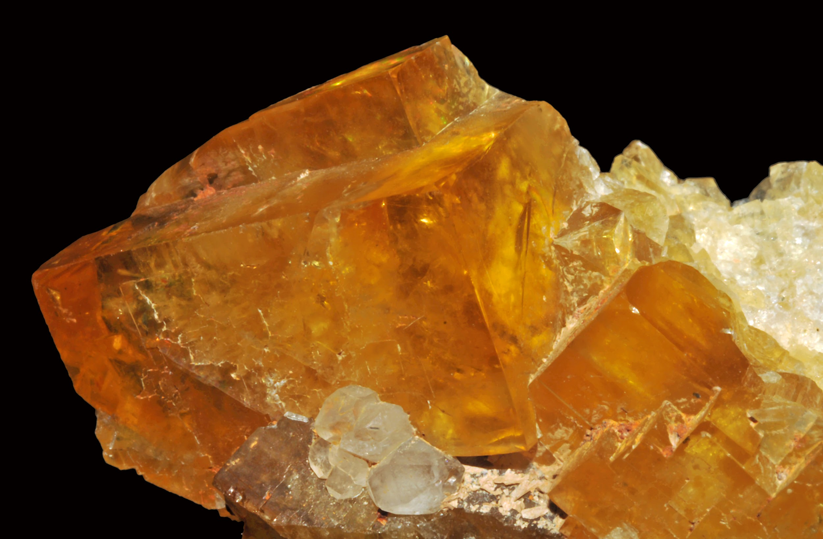
What is Fluoride?
Fluoride (F-)
Inorganic anion of Fluorine (F)
Simplest anion of Fluorine (F)
Most reactive nonmetal
The most electronegative element
Does not exist in elemental form
When combined with metal, forms a salt
Can substitute for hydrogen in many organic compounds
Distinct bitter taste
Mineral Forms
Fluorapatite - most common form, fluorinated calcium phosphate rock
Fluorite (CaF2) - 49% fluoride by mass, found worldwide
Sodium Fluoride (NaF)
Sodium Silicofluoride (Na2SiF6)

Slide 3
Where is it found?
Found in
Drinking water
Seawater
Ground & Surface waters - from natural deposits or from industrial/mining contamination
Toothpastes
Glass & steel manufacturing
Organic F - vegetables, fruits, & nuts
Inorganic F (NaF) - waste product of aluminum
Used In:
wire and cable insulations
pipe linings
rocket propellants
insecticides
rodenticides (rat poisons)
refrigerants
aerosol propellants
polymers for plastics
in the separation of uranium isotopes
the aluminum, beryllium, antimony, superphosphate fertilizer
glass
electronic ceramics
fluorspar
brick industries

Slide 4
Problems with Ingestion
Toothpaste:
Use too much toothpaste - should only be a “pea-sized” amount
most is advertised as 2-3x the amount actually necessary
Children’s toothpaste is flavored
kids want to swallow
Children’s swallowing reflex not fully developed
unable to fully control how much they ingest
Levels in most toothpastes:
Large tube (6.4 oz) - 192-211 mg F
Small tube (4.6 oz) - 138-152 mg F
FDA regulations and American Dental Association Seal of Acceptance require levels to be no more than 276 mg F per tube (small or large)
Water:
Uncontrolled levels in certain locations due to no regulation
Malfunction of fluoride treatment equipment - uncommon

Slide 5
Why is it used?
Fluorination in Water
CWF: Community Water Fluoridation
Prevention of dental caries & tooth decay
Frequent & constant low levels of fluoride
25% Reduction in tooth decay for adults and children
Saves Money
Cost-effective way of getting fluoride to everyone in a community
Reduces health care costs for families and the health care system
Possible therapeutic agent in treatment of osteoporosis
Further study is needed, however fluoride treatment has been used to treat osteoporosis
Other Fluoridation
Toothpaste: prevention of dental caries & tooth decay
International: Fluoridation of water, salt, & milk is supported by the World Health Organization for prevention of dental decay

Slide 6
Pharmacokinetics
Absorption
GI Tract: >90-95% rapidly absorbed
peak levels @ 30 mins on fasting stomach
if ingested with food, degree and rate of absorption decrease
Can cross the placental barrier & be absorbed by the fetus
Distributed via blood plasma
Deposited in bone and calcified tissues
Half-Life: 2-9 hours in plasma depending on dose, several years in bone
Excretion - Kidneys
40-60% excreted in urine
Elimination half-life: 5 hours
Can also be eliminated in sweat, breast milk, & saliva

Slide 7
Toxic Levels
Acute Toxicity
Levels: 1-5mg/kg; 15-30 mg/kg can be fatal
Examples:
Hayward water (maximum): 0.3 mg/L
Pea-sized amount of toothpaste: 0.3 mg
Chronic Toxicity
Effects
Creates oxidative stress in osteoblastic cells
Inflammation of bone tissue
Impairment of respiratory chain of liver
Increased superoxide radical production
Decreases oxygen consumption
Induced apoptosis of cells

Slide 8
Short Term Effects
Acute Effects
Very rare
Usually due to accidental poisonings
A study indicated that exposure is not harmful in the short term although some people may have a hypersensitivity reaction to it (Kaminsky, LS, et al.)
Symptoms
Nausea, vomiting, hypersalivation, abdominal pain, diarrhea
In severe cases:
convulsions, irregular heartbeat, and coma

Slide 9
Long Term Effects
Chronic Effects
These may occur after various levels of exposure in different people:
Dental Fluorosis: discoloration & mottling of teeth
Skeletal Fluorosis: bone crippling disorder similar to osteoporosis
Dental malformation
Decalcification
Mineralization of tendons
Digestive disorders
Nervous disorders
Hypersensitivity reactions
Renal insufficiency
Birth defects
Cancer
An analysis showed no difference in bone fluoride levels between people with osteosarcoma and people in a control group who had other malignant bone tumors (Kim, FM, C. Hayes, PL Williams, GM Whitford, KJ Joshipura, RN Hoover, CW Douglas, and National Osteosarcoma Etiology Group.)

Slide 10
Long Term Effects
Chronic kidney disease
Fluoride in drinking water and diet: the causative factor of chronic kidney diseases in the North Central Province of Sri Lanka. (Dharmaratne, RW.)
ADHD
Exposure to fluoridated water and ADHD prevalence among Children and Adolescents in the United States: An Ecological Association. (Malin, AJ and C. Till)
Fluoride and IQ (Fluoride Action Nextwork)
Summary of 50 studies have showed a relationship
43 of the 50 showed reduced learning/memory performance
Fluoride sources: water and coal burning
IQ reduction have been significantly associated with water fluoride levels ranging from 0.7 - 1.2 mg/L

Slide 11
Bibliography
"2011 Water Quality Report (Consumer Confidence Report)." (n.d.): n. pag.City of Hayward. Department of Public Works, 2011. Web. 15 May 2015.
"Community Water Fluoridation." CDC.gov. National Center for Chronic Disease Prevention and Health Promotion, n.d. Web. 18 May 2015. <http://www.cdc.gov/fluoridation/pdf/communitywaterfluoridationfactsheet.pdf>.
Bergamo, E., M. Barbana, R. Terada, JA Cury, and M. Fujimaki. "Fluoride Concentrations in the Water of Maringá, Brazil, considering the Benefit/risk Balance of Caries and Fluorosis." Brazilian Oral Research 29.1 (2015): n. pag. Web.
Dharmaratne, RW. "Fluoride in Drinking Water and Diet: The Causative Factor of Chronic Kidney Diseases in the North Central Province of Sri Lanka." Environ Health Prev Med (n.d.): n. pag. Web. 18 May 2015.
Fina, Brenda Lorena, Mercedes Lombarte, Juan Pablo Rigalli, and Alfredo Rigalli. "Fluoride Increases Superoxide Production and Impairs the Respiratory Chain in ROS 17/2.8 Osteoblastic Cells." PLoS ONE 9.6 (2014): n. pag. PMC. Web. 16 May 2015.
"Fluoride Action Network." Fluoride Action Network. N.p., n.d. Web. 18 May 2015.
"Fluoride Fact Sheet." Fluoridealert.org. Bureau of Reclimation, 21 Sept. 2001. Web. 18 May 2015. <http://fluoridealert.org/wp-content/pesticides/fluoroapatite.fact.sheet.01.pdf>.
"Fluoridated Water." National Cancer Institute. N.p., 2 Feb. 2012. Web. 18 May 2015.
Kaminsky, LS, MC Mahoney, J. Leach, J. Melius, and MJ Miller. "Fluoride: Benefits and Risks of Exposure." Crit Rev Oral Biol Med 1.4 (1990): 261-81. Web. 18 May 2015.
Kim, FM, C. Hayes, PL Williams, GM Whitford, KJ Joshipura, RN Hoover, CW Douglas, and National Osteosarcoma Etiology Group. "An Assessment of Bone Fluoride and Osteosarcoma." J Dent Res 90.10 (2011): 1171-176. Web.
Malin, AJ, and C. Till. "Exposure to Fluoridated Water and Attention Deficit Hyperactivity Disorder Prevalence among Children and Adolescents in the United States: An Ecological Association." Environ Health 14.1 (2015): 17. Web.

